Slide 1
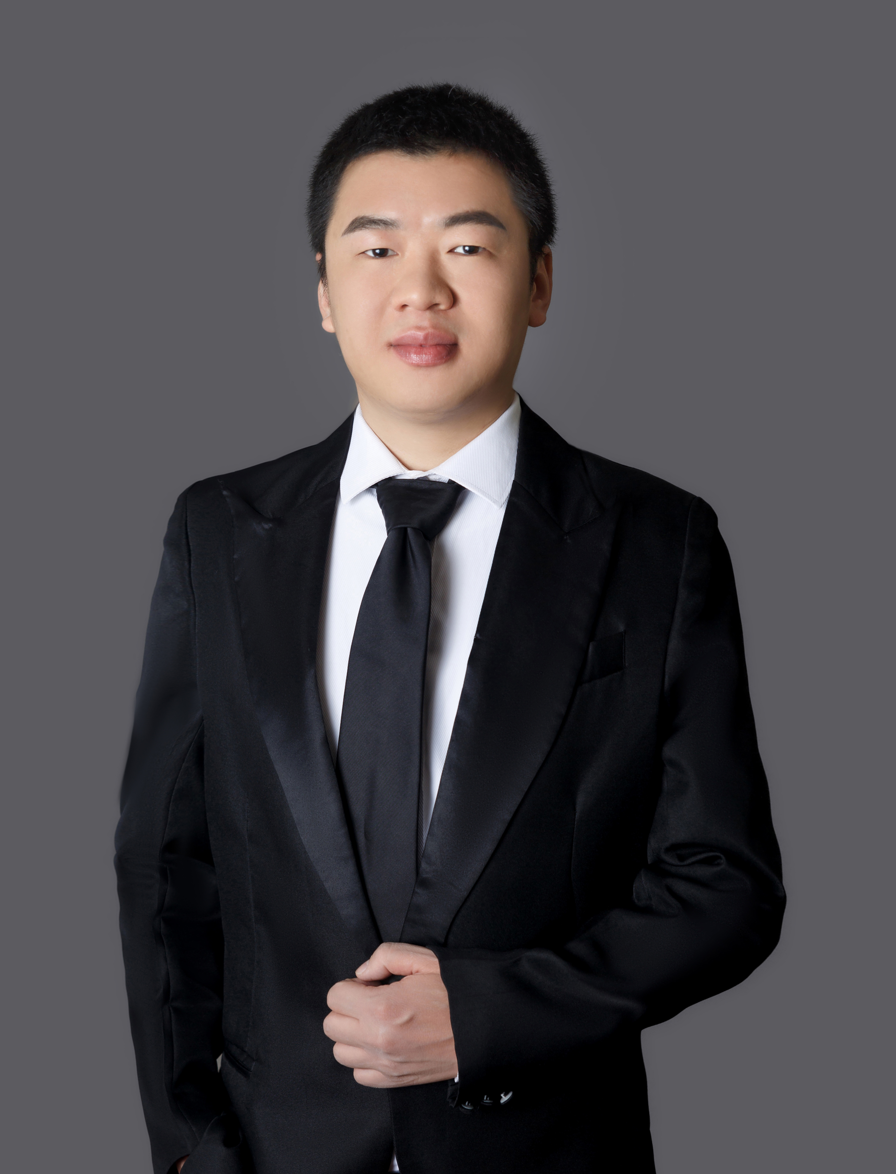


Explicit Min-wise Hash Families with Optimal Size
Xue Chen*
Shengtang Huang*
Xin Li†
* University of Science and Technology of China
† Johns Hopkins University

Slide 2
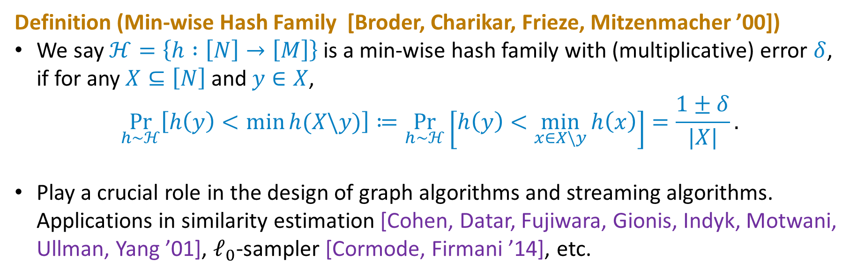
Min-wise Hash Family
Definition (Min-wise Hash Family [Broder, Charikar, Frieze, Mitzenmacher ’00])
We say $ℋ=\left\{h :\left[N\right]→\left[M\right]\right\}$ is a min-wise hash family with (multiplicative) error $δ$, if for any $X⊆\left[N\right]$ and $y∈X$,
$$\underset{h∼ℋ}{Pr}\left[h\left(y\right)<\min{h(X\backslash y)}\right]≔\underset{h∼ℋ}{Pr}\left[h\left(y\right)<\min_{x∈X\backslash y}{h\left(x\right)}\right]=\frac{1±δ}{|X|}.$$
Play a crucial role in the design of graph algorithms and streaming algorithms. Applications in similarity estimation [Cohen, Datar, Fujiwara, Gionis, Indyk, Motwani, Ullman, Yang ’01], $ℓ_{0}$-sampler [Cormode, Firmani ’14], etc.

Slide 3
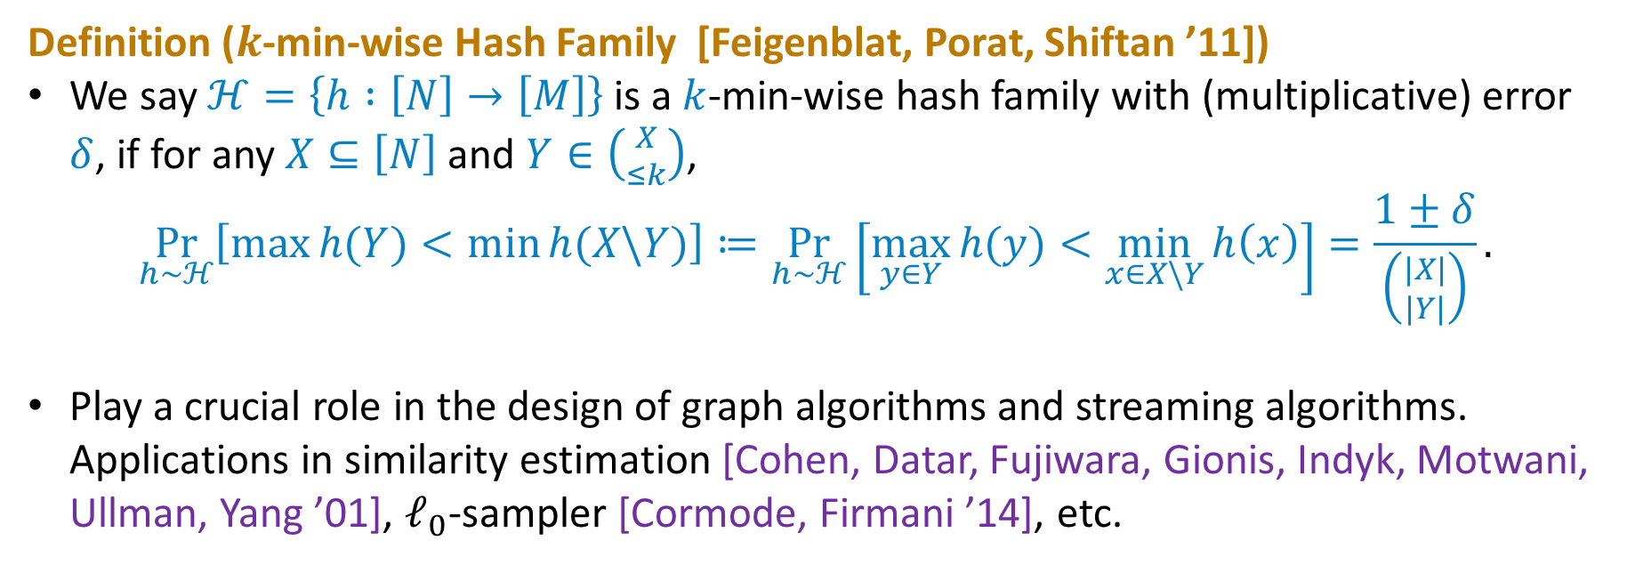

$k$-min-wise Hash Family
Definition ($k$-min-wise Hash Family [Feigenblat, Porat, Shiftan ’11])
We say $ℋ=\left\{h :\left[N\right]→\left[M\right]\right\}$ is a $k$-min-wise hash family with (multiplicative) error $δ$, if for any $X⊆\left[N\right]$ and $Y∈\left({X \atop ≤k}\right)$,
$$\underset{h∼ℋ}{Pr}\left[\max{h(Y)}<\min{h(X\backslash Y)}\right]≔\underset{h∼ℋ}{Pr}\left[\max_{y∈Y}{h(y)}<\min_{x∈X\backslash Y}{h\left(x\right)}\right]=\frac{1±δ}{\left({|X| \atop |Y|}\right)}.$$
Play a crucial role in the design of graph algorithms and streaming algorithms. Applications in similarity estimation [Cohen, Datar, Fujiwara, Gionis, Indyk, Motwani, Ullman, Yang ’01], $ℓ_{0}$-sampler [Cormode, Firmani ’14], etc.

Slide 4

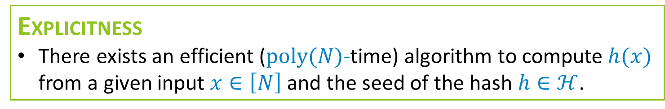
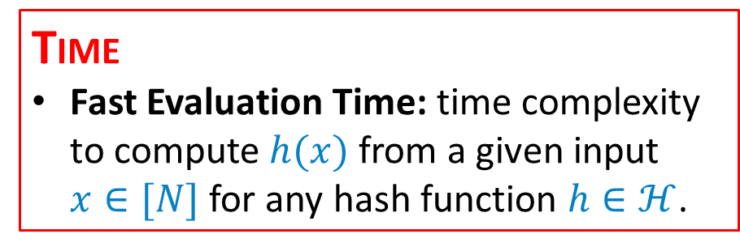
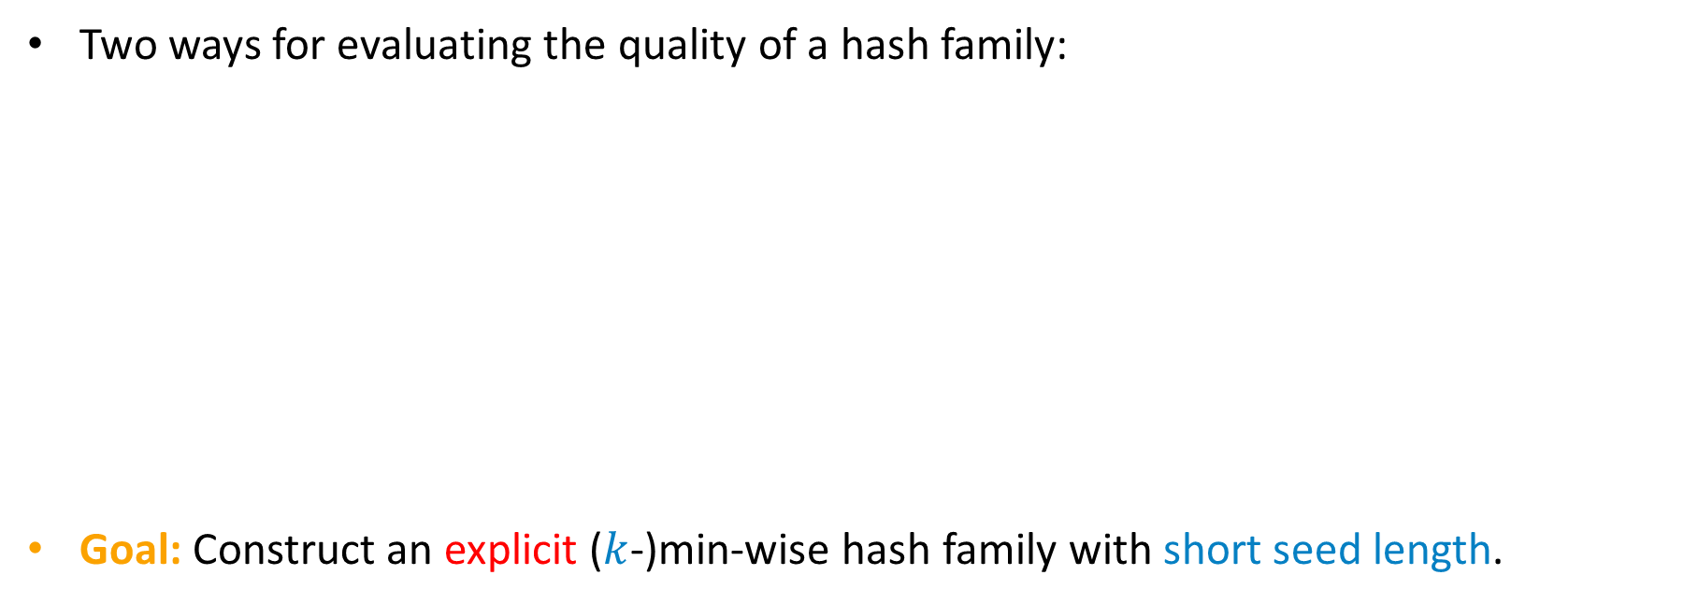
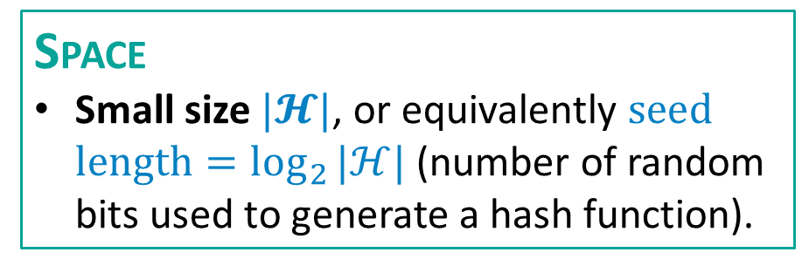
Problem – A Good Min-wise Hash Family
Two ways for evaluating the quality of a hash family:
Goal: Construct an explicit ($k$-)min-wise hash family with short seed length.
TIME
Fast Evaluation Time: time complexity to compute $h(x)$ from a given input $x∈[N]$ for any hash function $h∈ℋ$.
SPACE
Small size $|𝓗|$, or equivalently $\text{seed} \text{length}=\log_{2}{|ℋ|}$ (number of random bits used to generate a hash function).
EXPLICITNESS
There exists an efficient ($\text{poly}(N)$-time) algorithm to compute $h(x)$ from a given input $x∈\left[N\right]$ and the seed of the hash $h∈ℋ$.

Slide 5
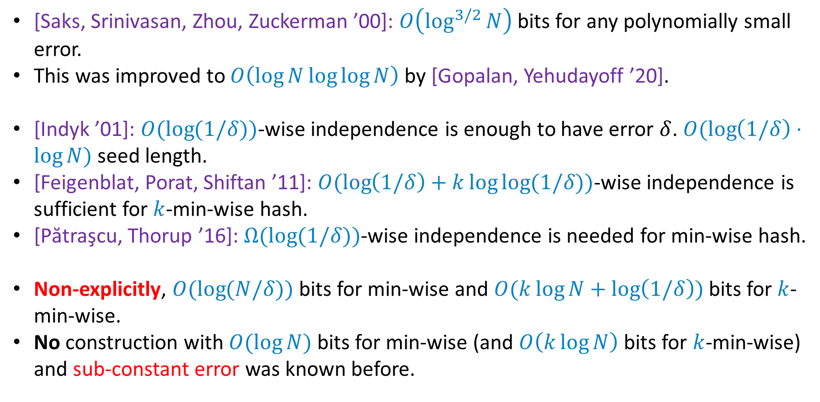
Prior Works
[Saks, Srinivasan, Zhou, Zuckerman ’00]: $O\left(\log^{3/2}{N}\right)$ bits for any polynomially small error.
This was improved to $O\left(\log{N}\log{\log{N}}\right)$ by [Gopalan, Yehudayoff ’20].
[Indyk ’01]: $O(\log{(1/δ))}$-wise independence is enough to have error $δ$. $O(\log\left(1/δ\right)⋅\log{N})$ seed length.
[Feigenblat, Porat, Shiftan ’11]: $O(\log\left(1/δ\right)+k\log{\log{(1/δ)}})$-wise independence is sufficient for $k$-min-wise hash.
[Pătraşcu, Thorup ’16]: $Ω(\log{(1/δ))}$-wise independence is needed for min-wise hash.
Non-explicitly, $O(\log{(N/δ))}$ bits for min-wise and $O(k\log{N}+\log\left(1/δ\right))$ bits for $k$-min-wise.
No construction with $O(\log{N)}$ bits for min-wise (and $O\left(k\log{N}\right)$ bits for $k$-min-wise) and sub-constant error was known before.

Slide 6
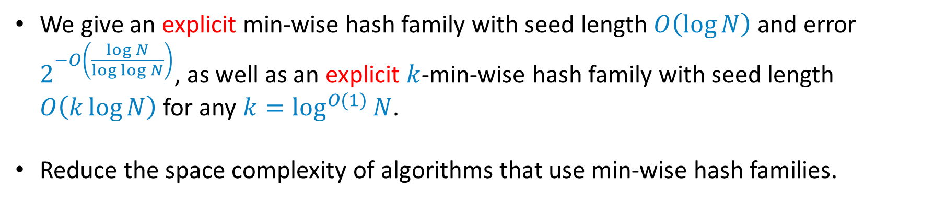
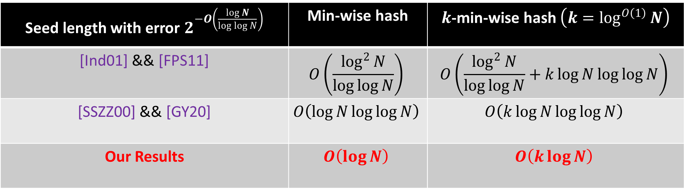
Our Results
We give an explicit min-wise hash family with seed length $O\left(\log{N}\right)$ and error $2^{−O\left(\frac{\log{N}}{\log{\log{N}}}\right)}$, as well as an explicit $k$-min-wise hash family with seed length $O\left(k\log{N}\right)$ for any $k=\log^{O(1)}{N}$.
Reduce the space complexity of algorithms that use min-wise hash families.
Seed length with error $2^{−O\left(\frac{\log{N}}{\log{\log{N}}}\right)}$ | Min-wise hash | $k$-min-wise hash $\left(k=\log^{O\left(1\right)}{N}\right)$
[Ind01] && [FPS11] | $$O\left(\frac{\log^{2}{N}}{\log{\log{N}}}\right)$$ | $$O\left(\frac{\log^{2}{N}}{\log{\log{N}}}+k\log{N}\log{\log{N}}\right)$$
[SSZZ00] && [GY20] | $$O\left(\log{N}\log{\log{N}}\right)$$ | $$O\left(k\log{N}\log{\log{N}}\right)$$
Our Results | $$O\left(\log{N}\right)$$ | $$O\left(k\log{N}\right)$$

Slide 7
Polynomially Small Error
[Saks, Srinivasan, Zhou, Zuckerman ’00] && [Gopalan, Yehudayoff ’20]

Slide 8
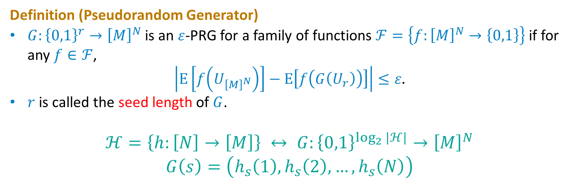
Hash Family as Pseudorandom Generator
Definition (Pseudorandom Generator)
$G:{\left\{0,1\right\}}^{r}→{\left[M\right]}^{N}$ is an $ε$-PRG for a family of functions $ℱ=\left\{f:{\left[M\right]}^{N}→\left\{0,1\right\}\right\}$ if for any $f∈ℱ$,
$$\left|\text{E}\left[f\left(U_{{\left[M\right]}^{N}}\right)\right]−\text{E}\left[f\left(G\left(U_{r}\right)\right)\right]\right|≤ε.$$
$r$ is called the seed length of $G$.
$$ℋ=\left\{h:\left[N\right]→\left[M\right]\right\} ↔ G:{\left\{0,1\right\}}^{\log_{2}{|ℋ|}}→{\left[M\right]}^{N}$$
$$G\left(s\right)=\left(h_{s}\left(1\right),h_{s}\left(2\right),…,h_{s}\left(N\right)\right)$$

Slide 9
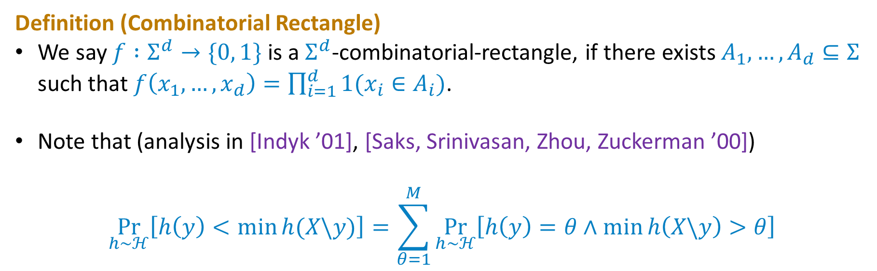
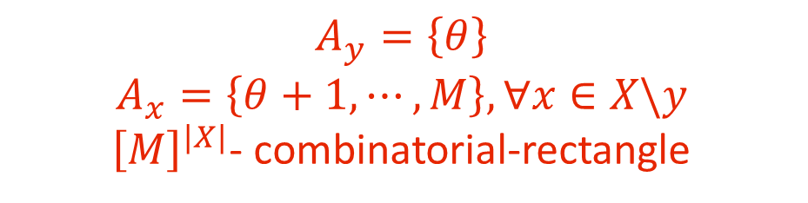
Decompose into Sum of Combinatorial Rectangles
Definition (Combinatorial Rectangle)
We say $f :Σ^{d}→\{0, 1\}$ is a $Σ^{d}$-combinatorial-rectangle, if there exists $A_{1}, …, A_{d}⊆Σ$ such that $f\left(x_{1},…,x_{d}\right)=\prod_{i=1}^{d}{1(x_{i}∈A_{i})}$.
Note that (analysis in [Indyk ’01], [Saks, Srinivasan, Zhou, Zuckerman ’00])
$$\underset{h∼ℋ}{Pr}\left[h\left(y\right)<\min{h(X\backslash y)}\right]=\sum_{θ=1}^{M}{\underset{h∼ℋ}{Pr}\left[h\left(y\right)=θ∧\min{h\left(X\backslash y\right)}>θ\right]}$$
$$A_{y}=\left\{θ\right\}$$
$$A_{x}=\left\{θ+1,⋯,M\right\}, ∀x∈X\backslash y$$
${\left[M\right]}^{|X|}$- combinatorial-rectangle

Slide 10
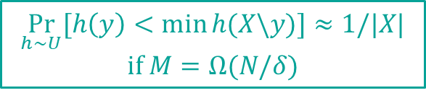
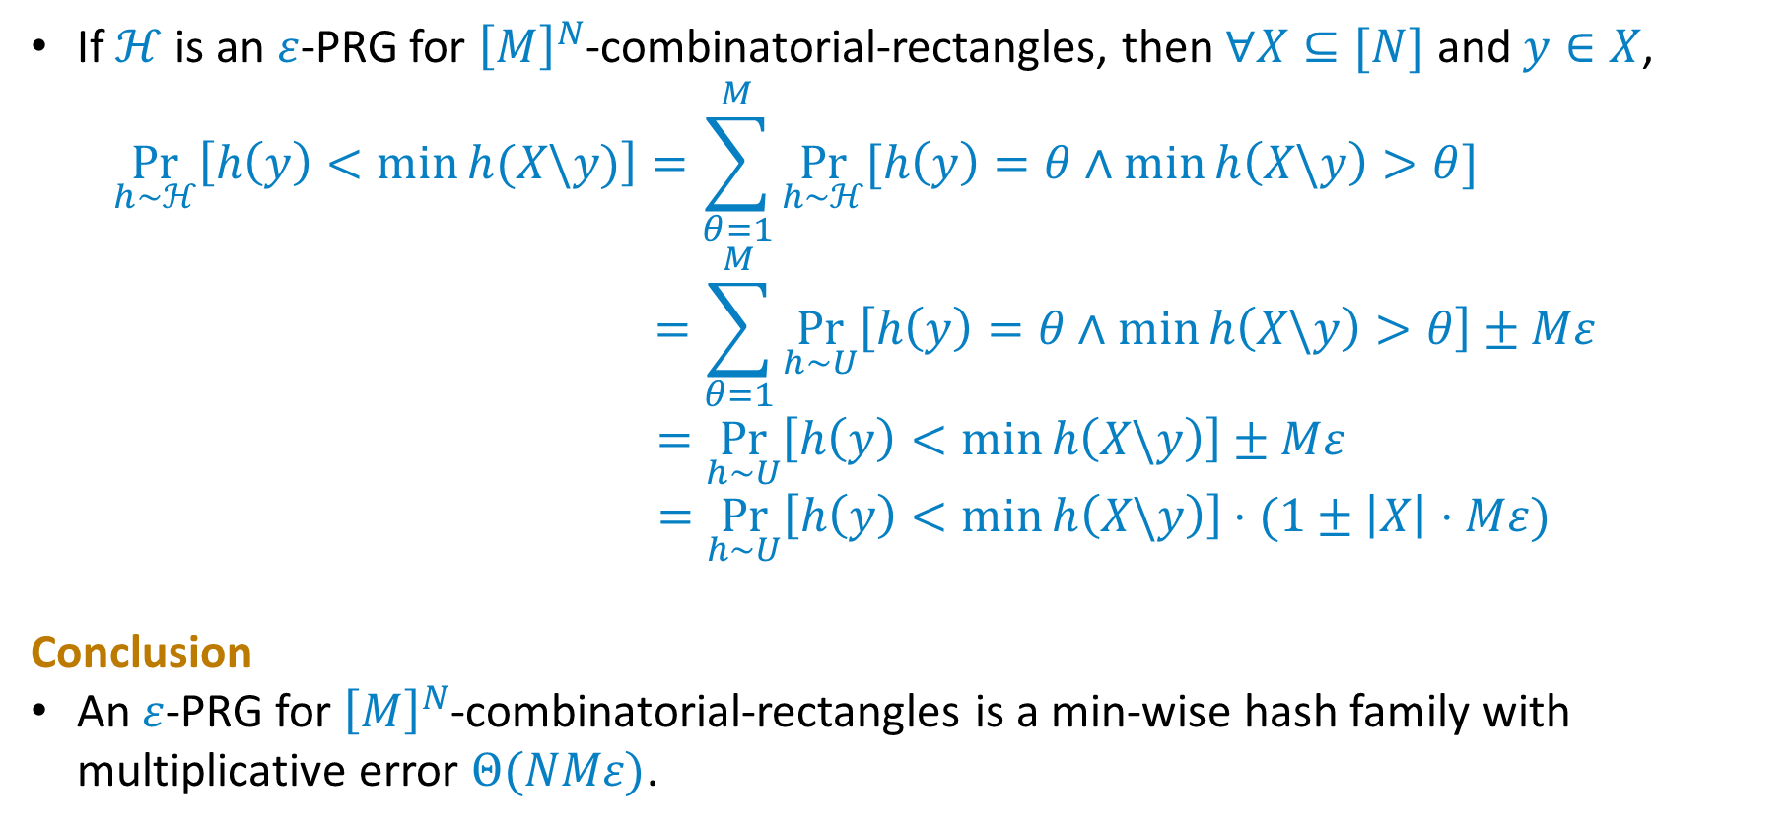
Connection with PRG for Combinatorial Rectangles
If $ℋ$ is an $ε$-PRG for ${\left[M\right]}^{N}$-combinatorial-rectangles, then $∀X⊆[N]$ and $y∈X$,
$$\underset{h∼ℋ}{Pr}\left[h\left(y\right)<\min{h(X\backslash y)}\right]=\sum_{θ=1}^{M}{\underset{h∼ℋ}{Pr}{[h\left(y\right)=θ∧\min{h\left(X\backslash y\right)}>θ]}}$$
$$=\sum_{θ=1}^{M}{\underset{h∼U}{Pr}\left[h\left(y\right)=θ∧\min{h\left(X\backslash y\right)}>θ\right]}±Mε$$
$$=\underset{h∼U}{Pr}\left[h\left(y\right)<\min{h\left(X\backslash y\right)}\right]±Mε$$
$$=\underset{h∼U}{Pr}\left[h\left(y\right)<\min{h\left(X\backslash y\right)}\right]⋅(1±\left|X\right|⋅Mε)$$
Conclusion
An $ε$-PRG for ${\left[M\right]}^{N}$-combinatorial-rectangles is a min-wise hash family with multiplicative error $Θ(NMε)$.
$$\underset{h∼U}{Pr}{[h\left(y\right)<\min{h(X\backslash y)]≈1/|X|}}$$
$$\text{if} M=Ω(N/δ)$$

Slide 11
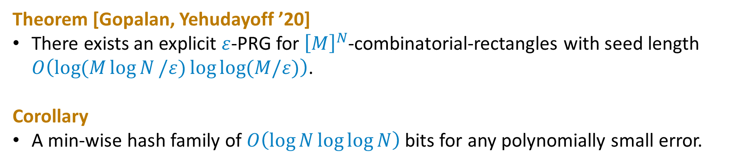
Connection with PRG for Combinatorial Rectangles
Theorem [Gopalan, Yehudayoff ’20]
There exists an explicit $ε$-PRG for ${\left[M\right]}^{N}$-combinatorial-rectangles with seed length $O\left(\log{(M\log{N}/ε)}\log{\log{(M/ε)}}\right)$.
Corollary
A min-wise hash family of ⁡$O\left(\log{N}\log{\log{N}}\right)$ bits for any polynomially small error.

Slide 12
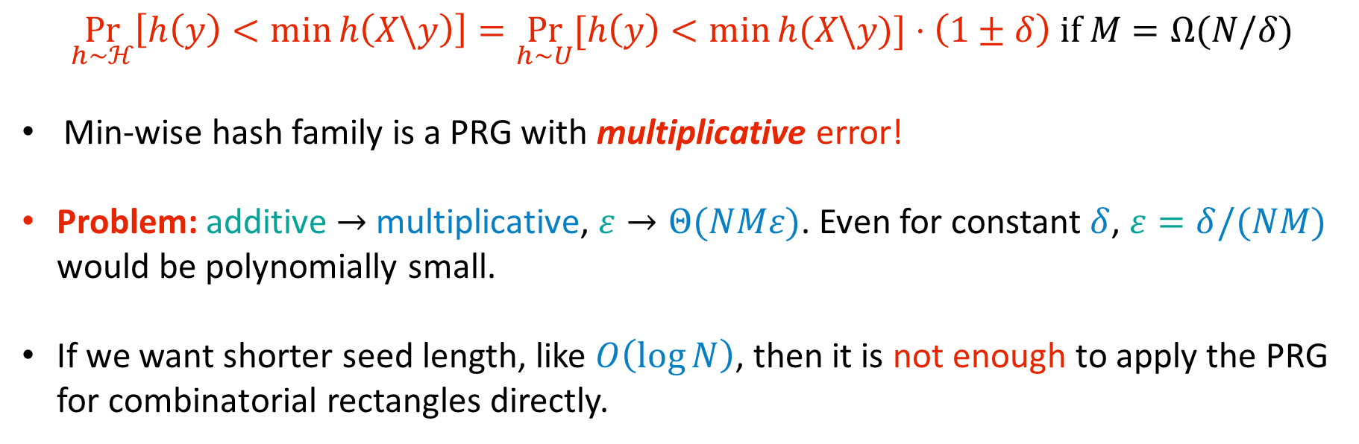
Gap between Multiplicative and Additive Errors
$$\underset{h∼ℋ}{Pr}\left[h\left(y\right)<\min{h\left(X\backslash y\right)}\right]=\underset{h∼U}{Pr}{[h\left(y\right)<\min{h(X\backslash y)]}}⋅\left(1±δ\right) \text{if} M=Ω(N/δ)$$
Min-wise hash family is a PRG with multiplicative error!
Problem: additive $→$ multiplicative, $ε→Θ(NMε)$. Even for constant $δ$, $ε=δ/(NM)$ would be polynomially small.
If we want shorter seed length, like $O\left(\log{N}\right)$, then it is not enough to apply the PRG for combinatorial rectangles directly.

Slide 13
Optimal Size && Sub-constant Error
Our Approach [Chen, Huang, Li ’2025]

Slide 14
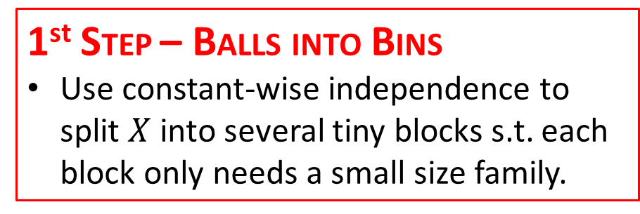
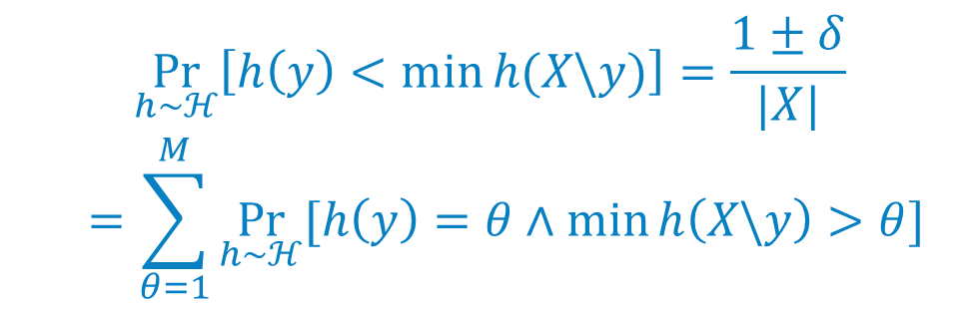
1st STEP – BALLS INTO BINS
Use constant-wise independence to split $X$ into several tiny blocks s.t. each block only needs a small size family.
$$\underset{h∼ℋ}{Pr}\left[h\left(y\right)<\min{h(X\backslash y)}\right]=\frac{1±δ}{|X|}$$
$$=\sum_{θ=1}^{M}{\underset{h∼ℋ}{Pr}{[h\left(y\right)=θ∧\min{h\left(X\backslash y\right)>θ}]}}$$
2nd STEP – RECYCLE RANDOMNESS
Use the Nisan-Zuckerman PRG and a special extractor to recycle randomness between blocks.
3rd STEP – DOMAIN REDUCTION
Use PRGs for combinatorial rectangles and the special extractor to further reduce the error.

Slide 15

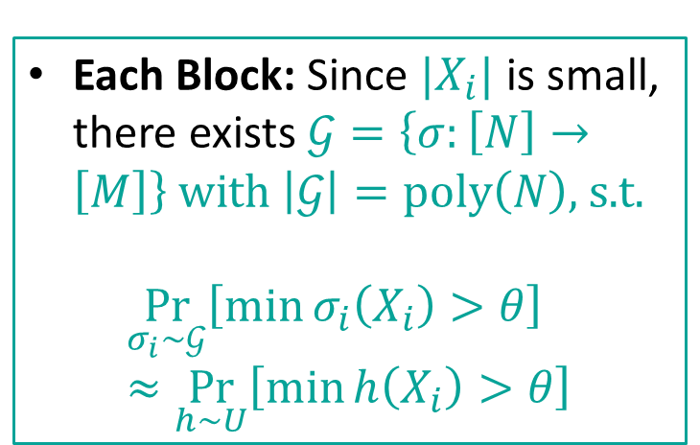



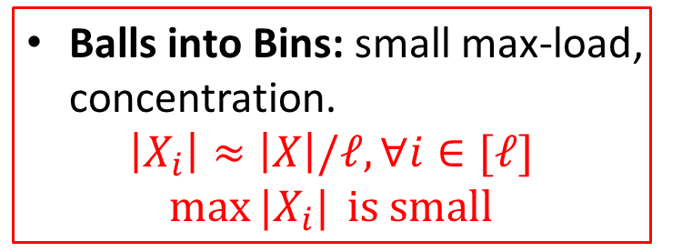

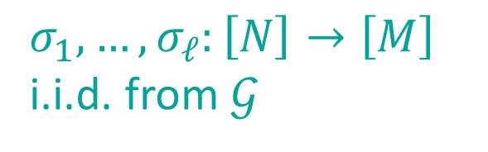
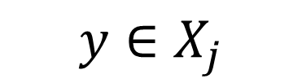

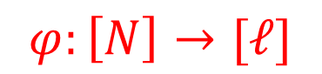

Two Level Hash Structure
$$h\left(x\right)=σ_{φ\left(x\right)}(x)$$
$$X$$
Balls into Bins: small max-load, concentration.
$$\left|X_{i}\right|≈\left|X\right|/ℓ, ∀i∈[ℓ]$$
$$\max{|X_{i}|} \text{is} \text{small}$$
$$φ:\left[N\right]→[ℓ]$$
Constant-wise independence
$$⋯$$
$$y∈X_{j}$$
$$⋯$$
$$X_{1}$$
$$X_{ℓ}$$
Each Block: Since $|X_{i}|$ is small, there exists $𝒢=\left\{σ:\left[N\right]→\left[M\right]\right\} \text{with} \left|𝒢\right|=\text{poly}\left(N\right)\text{, }\text{s}\text{.}\text{t}\text{.}$
$$\underset{σ_{i}∼𝒢}{Pr}\left[\min{σ_{i}\left(X_{i}\right)}>θ\right]≈\underset{h∼U}{Pr}\left[\min{h\left(X_{i}\right)}>θ\right]$$
$$σ_{1},…,σ_{ℓ}:\left[N\right]→\left[M\right]$$
i.i.d. from $𝒢$
$$[M]$$

Slide 16
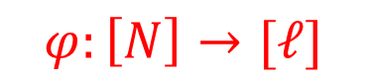


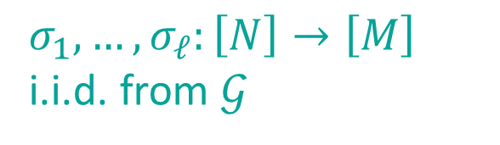


Split into Several Small Blocks
$$h\left(x\right)=σ_{φ\left(x\right)}(x)$$
$$\underset{h∼ℋ}{Pr}{[h\left(y\right)=θ∧\min{h\left(X\backslash y\right)}>θ]}$$
$$=$$
$$φ:\left[N\right]→[ℓ]$$
$$\underset{σ_{1}∼𝒢}{Pr}{[\min{σ_{1}\left(X_{1}\right)}>θ]}⋯\underset{σ_{j}∼𝒢}{Pr}\left[σ_{j}\left(y\right)=θ∧\min{σ_{j}\left(X_{j}\backslash y\right)}>θ\right]⋯\underset{σ_{ℓ}∼𝒢}{Pr}\left[\min{σ_{ℓ}\left(X_{ℓ}\right)}>θ\right]$$
$$≈$$
$$\underset{σ_{i}∼𝒢}{Pr}\left[\min{σ_{i}\left(X_{i}\right)}>θ\right]≈\underset{h∼U}{Pr}\left[\min{h\left(X_{i}\right)}>θ\right]$$
$σ_{1},…,σ_{ℓ}:\left[N\right]→\left[M\right]$ i.i.d. from $𝒢$
Require many random bits.
$$\underset{h∼U}{Pr}{[\min{h\left(X_{1}\right)}>θ]}⋯\underset{h∼U}{Pr}\left[h\left(y\right)=θ∧\min{h\left(X_{j}\backslash y\right)}>θ\right]⋯\underset{h∼U}{Pr}\left[\min{h\left(X_{ℓ}\right)}>θ\right]$$
$$=\underset{h∼U}{Pr}\left[h\left(y\right)=θ∧\min{h(X\backslash y)}>θ\right]$$

Slide 17
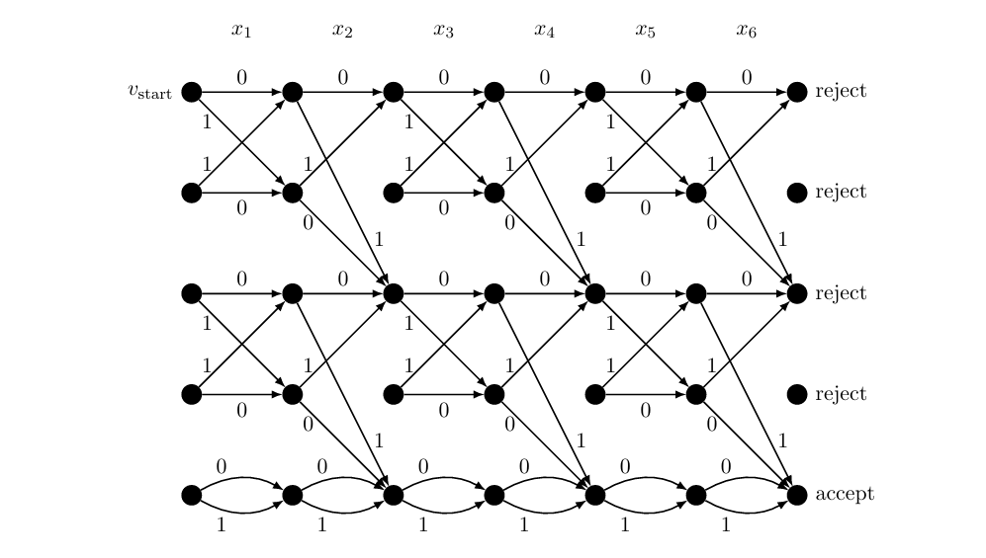
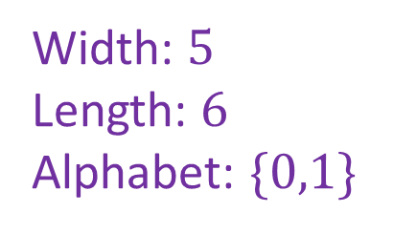
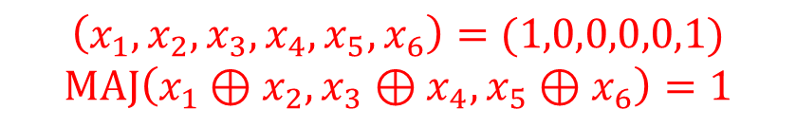
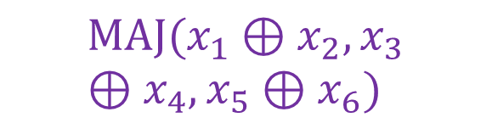
Read-once Branching Program
Width: $5$
Length: $6$
Alphabet: $\{0,1\}$
$$\left(x_{1},x_{2},x_{3},x_{4},x_{5},x_{6}\right)=(1,0,0,0,0,1)$$
$$\text{MAJ}\left(x_{1}⊕x_{2},x_{3}⊕x_{4},x_{5}⊕x_{6}\right)=1$$
$$\text{MAJ}(x_{1}⊕x_{2},x_{3}⊕x_{4},x_{5}⊕x_{6})$$

Slide 18




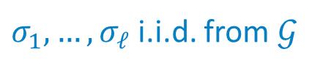
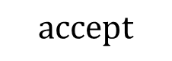




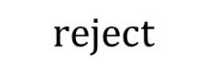



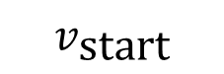
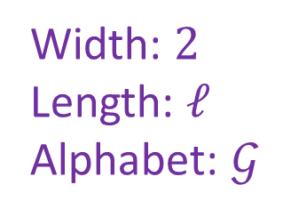




Recycle Randomness
$$\left(\min{σ_{1}\left(X_{1}\right)}>θ\right)∧⋯∧\left(σ_{j}(y)=θ∧\min{σ_{j}\left(X_{j}\backslash y\right)>θ}\right)∧⋯∧\left(\min{σ_{ℓ}\left(X_{ℓ}\right)}>θ\right)$$
$$\text{Ev}\text{ent} A_{1}$$
$$\text{Ev}\text{ent} A_{j}$$
$$\text{Event} A_{ℓ}$$
$σ_{1},…,σ_{ℓ}$ i.i.d. from $𝒢$
$$⋯⋯$$
$$\text{reject}$$
$$A_{1} \text{false}$$
Width: $2$
Length: $ℓ$
Alphabet: $𝒢$
$$v_{\text{start}}$$
$$A_{2} \text{false}$$
$$A_{ℓ} \text{false}$$
$$A_{1} \text{true}$$
$$⋯⋯$$
$$\text{accept}$$
$$A_{2} \text{true}$$
$$A_{ℓ} \text{true}$$
$$σ_{1}$$
$$σ_{2}$$
$$⋯⋯$$
$$σ_{ℓ}$$

Slide 19






Recycle Randomness
$$\left(\min{σ_{1}\left(X_{1}\right)}>θ\right)∧⋯∧\left(σ_{j}(y)=θ∧\min{σ_{j}\left(X_{j}\backslash y\right)>θ}\right)∧⋯∧\left(\min{σ_{ℓ}\left(X_{ℓ}\right)}>θ\right)$$
$$\text{Ev}\text{ent} A_{1}$$
$$\text{Ev}\text{ent} A_{j}$$
$$\text{Event} A_{ℓ}$$
$σ_{1},…,σ_{ℓ}$ i.i.d. from $𝒢$
$$≈$$
$$\left(\min{σ_{1}^{′}\left(X_{1}\right)}>θ\right)∧⋯∧\left(σ_{j}^{′}(y)=θ∧\min{σ_{j}^{′}\left(X_{j}\backslash y\right)>θ}\right)∧⋯∧\left(\min{σ_{ℓ}^{′}\left(X_{ℓ}\right)}>θ\right)$$
$σ_{1}^{′},…,σ_{ℓ}^{′}$ are correlated
$$⋯⋯$$
$$\text{reject}$$
$$A_{1} \text{false}$$
Width: $2$
Length: $ℓ$
Alphabet: $𝒢$
$$v_{\text{start}}$$
$$A_{2} \text{false}$$
$$A_{ℓ} \text{false}$$
$$A_{1} \text{true}$$
$$⋯⋯$$
$$\text{accept}$$
$$A_{2} \text{true}$$
$$A_{ℓ} \text{true}$$
$$σ_{1}^{′}$$
$$σ_{2}^{′}$$
$$⋯⋯$$
$$σ_{ℓ}^{′}$$

Slide 20
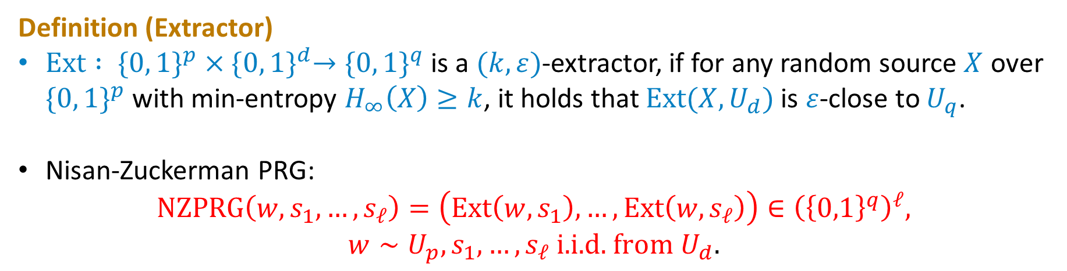
Nisan-Zuckerman PRG
Definition (Extractor)
$\text{Ext} : \{0, 1\}^{p}×{\{0, 1\}}^{d}→{\{0, 1\}}^{q}$ is a $(k, ε)$-extractor, if for any random source $X$ over $\{0, 1\}^{p}$ with min-entropy $H_{∞}\left(X\right)≥k$, it holds that $\text{Ext}(X, U_{d})$ is $ε$-close to $U_{q}$.
Nisan-Zuckerman PRG:
$$\text{NZPRG}\left(w, s_{1},…,s_{ℓ}\right)=\left(\text{Ext}\left(w,s_{1}\right),…,\text{Ext}\left(w,s_{ℓ}\right)\right)∈{\left({\left\{0,1\right\}}^{q}\right)}^{ℓ},$$
$$w∼U_{p}, s_{1},…,s_{ℓ} \text{i}\text{.}\text{i}\text{.}\text{d}\text{.} \text{from} U_{d}.$$

Slide 21


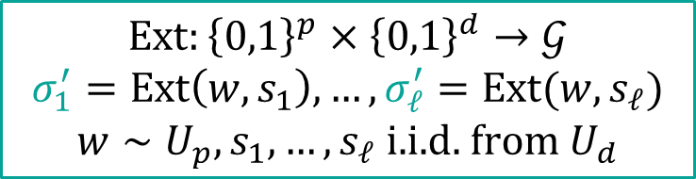

Nisan-Zuckerman PRG
$$\left(\min{σ_{1}^{′}\left(X_{1}\right)}>θ\right)∧⋯∧\left(σ_{j}^{′}(y)=θ∧\min{σ_{j}^{′}\left(X_{j}\backslash y\right)>θ}\right)∧⋯∧\left(\min{σ_{ℓ}^{′}\left(X_{ℓ}\right)}>θ\right)$$
$$\text{Ev}\text{ent} A_{1}$$
$$\text{Ev}\text{ent} A_{j}$$
$$\text{Event} A_{ℓ}$$
$$\text{Ext}:{\left\{0,1\right\}}^{p}×{\left\{0,1\right\}}^{d}→𝒢$$
$$σ_{1}^{′}=\text{Ext}\left(w,s_{1}\right),…,σ_{ℓ}^{′}=\text{Ext}(w,s_{ℓ})$$
$$w∼U_{p},s_{1},…,s_{ℓ} \text{i}\text{.}\text{i}\text{.}\text{d}\text{. }\text{from} U_{d}$$
$$⋯⋯$$
$$\text{reject}$$
$$A_{1} \text{false}$$
Width: $2$
Length: $ℓ$
Alphabet: $𝒢$
$$v_{\text{start}}$$
$$A_{2} \text{false}$$
$$A_{ℓ} \text{false}$$
$$A_{1} \text{true}$$
$$⋯⋯$$
$$\text{accept}$$
$$A_{2} \text{true}$$
$$A_{ℓ} \text{true}$$
$$σ_{1}^{′}$$
$$σ_{2}^{′}$$
$$⋯⋯$$
$$σ_{ℓ}^{′}$$

Slide 22
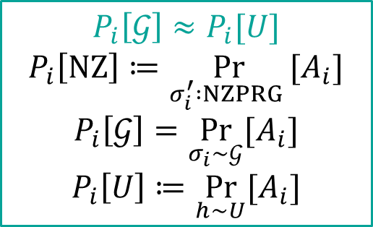
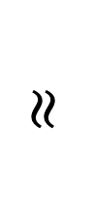
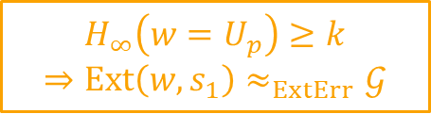
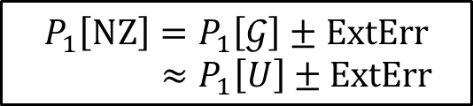
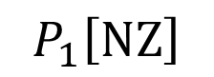
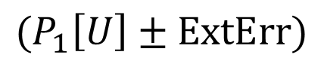
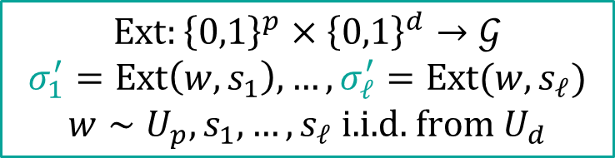
Analysis
$$\text{Ext}:{\left\{0,1\right\}}^{p}×{\left\{0,1\right\}}^{d}→𝒢$$
$$σ_{1}^{′}=\text{Ext}\left(w,s_{1}\right),…,σ_{ℓ}^{′}=\text{Ext}(w,s_{ℓ})$$
$$w∼U_{p},s_{1},…,s_{ℓ} \text{i}\text{.}\text{i}\text{.}\text{d}\text{. }\text{from} U_{d}$$
$$P_{1}\left[\text{NZ}\right]$$
$$≈$$
$$(P_{1}\left[U\right]±\text{ExtErr}\text{)}$$
$$P_{1}\left[\text{NZ}\right]=P_{1}\left[𝒢\right]±\text{ExtErr}$$
$$≈P_{1}\left[U\right]±ExtErr$$
$$P_{i}\left[𝒢\right]≈P_{i}[U]$$
$$P_{i}\left[\text{NZ}\right]≔\underset{σ_{i}^{′} :NZPRG }{Pr}{[A_{i}]}$$
$$P_{i}\left[𝒢\right]=\underset{σ_{i}∼𝒢}{Pr}{[A_{i}]}$$
$$P_{i}\left[U\right]≔\underset{h∼U}{Pr}{[A_{i}]}$$
$$H_{∞}\left(w=U_{p}\right)≥k$$
$$⇒\text{Ext}\left(w,s_{1}\right)≈_{ExtErr}𝒢$$
$$⋯⋯$$
$$\text{reject}$$
$$A_{1} \text{false}$$
Width: $2$
Length: $ℓ$
Alphabet: $𝒢$
$$v_{\text{start}}$$
$$A_{2} \text{false}$$
$$A_{ℓ} \text{false}$$
$$A_{1} \text{true}$$
$$⋯⋯$$
$$\text{accept}$$
$$A_{2} \text{true}$$
$$A_{ℓ} \text{true}$$
$$σ_{1}^{′}$$
$$σ_{2}^{′}$$
$$⋯⋯$$
$$σ_{ℓ}^{′}$$

Slide 23
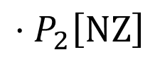


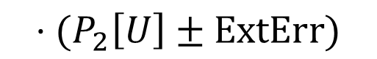
Analysis
$$\text{Ext}:{\left\{0,1\right\}}^{p}×{\left\{0,1\right\}}^{d}→𝒢$$
$$σ_{1}^{′}=\text{Ext}\left(w,s_{1}\right),…,σ_{ℓ}^{′}=\text{Ext}(w,s_{ℓ})$$
$$w∼U_{p},s_{1},…,s_{ℓ} \text{i}\text{.}\text{i}\text{.}\text{d}\text{. }\text{from} U_{d}$$
$$P_{1}\left[\text{NZ}\right]$$
$$⋅P_{2}\left[\text{NZ}\right]$$
$$≈$$
$$(P_{1}\left[U\right]±\text{ExtErr}\text{)}$$
$$⋅(P_{2}\left[U\right]±\text{ExtErr}\text{)}$$
$$P_{i}\left[𝒢\right]≈P_{i}[U]$$
$$P_{i}\left[\text{NZ}\right]≔\underset{σ_{i}^{′} :NZPRG }{Pr}{[A_{i}]}$$
$$P_{i}\left[𝒢\right]=\underset{σ_{i}∼𝒢}{Pr}{[A_{i}]}$$
$$P_{i}\left[U\right]≔\underset{h∼U}{Pr}{[A_{i}]}$$
$$H_{∞}\left(w∣A_{1}\right)≥k$$
$$⇒\text{Ext}\left(w∣A_{1},s_{2}\right)≈_{ExtErr}𝒢$$
$$\operatorname{Pr}{[A_{1}A_{2}]}=\operatorname{Pr}\left[A_{1}\right]⋅Pr⁡[A_{2}∣A_{1}]$$
$$⋯⋯$$
$$\text{reject}$$
$$A_{1} \text{false}$$
Width: $2$
Length: $ℓ$
Alphabet: $𝒢$
$$v_{\text{start}}$$
$$A_{2} \text{false}$$
$$A_{ℓ} \text{false}$$
$$A_{1} \text{true}$$
$$⋯⋯$$
$$\text{accept}$$
$$A_{2} \text{true}$$
$$A_{ℓ} \text{true}$$
$$σ_{1}^{′}$$
$$σ_{2}^{′}$$
$$⋯⋯$$
$$σ_{ℓ}^{′}$$

Slide 24


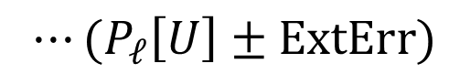
Analysis
$$\text{Ext}:{\left\{0,1\right\}}^{p}×{\left\{0,1\right\}}^{d}→𝒢$$
$$σ_{1}^{′}=\text{Ext}\left(w,s_{1}\right),…,σ_{ℓ}^{′}=\text{Ext}(w,s_{ℓ})$$
$$w∼U_{p},s_{1},…,s_{ℓ} \text{i}\text{.}\text{i}\text{.}\text{d}\text{. }\text{from} U_{d}$$
$$P_{1}\left[\text{NZ}\right]$$
$$⋅P_{2}\left[\text{NZ}\right]$$
$$⋯P_{ℓ}\left[\text{NZ}\right]$$
$$≈$$
$$(P_{1}\left[U\right]±\text{ExtErr}\text{)}$$
$$⋅(P_{2}\left[U\right]±\text{ExtErr}\text{)}$$
$$⋯(P_{ℓ}\left[U\right]±\text{ExtErr}\text{)}$$
$$P_{i}\left[𝒢\right]≈P_{i}[U]$$
$$P_{i}\left[\text{NZ}\right]≔\underset{σ_{i}^{′} :NZPRG }{Pr}{[A_{i}]}$$
$$P_{i}\left[𝒢\right]=\underset{σ_{i}∼𝒢}{Pr}{[A_{i}]}$$
$$P_{i}\left[U\right]≔\underset{h∼U}{Pr}{[A_{i}]}$$
$$H_{∞}\left(w∣A_{1}⋯A_{ℓ−1}\right)≥k$$
$$⇒\text{Ext}\left(w∣A_{1}⋯A_{ℓ−1},s_{ℓ}\right)≈_{ExtErr}𝒢$$
$$\operatorname{Pr}{[A_{1}⋯A_{ℓ}]}=\operatorname{Pr}\left[A_{1}⋯A_{ℓ−1}\right]⋅Pr⁡[A_{ℓ}∣A_{1}⋯A_{ℓ−1}]$$
$$⋯⋯$$
$$\text{reject}$$
$$A_{1} \text{false}$$
Width: $2$
Length: $ℓ$
Alphabet: $𝒢$
$$v_{\text{start}}$$
$$A_{2} \text{false}$$
$$A_{ℓ} \text{false}$$
$$A_{1} \text{true}$$
$$⋯⋯$$
$$\text{accept}$$
$$A_{2} \text{true}$$
$$A_{ℓ} \text{true}$$
$$σ_{1}^{′}$$
$$σ_{2}^{′}$$
$$⋯⋯$$
$$σ_{ℓ}^{′}$$

Slide 25
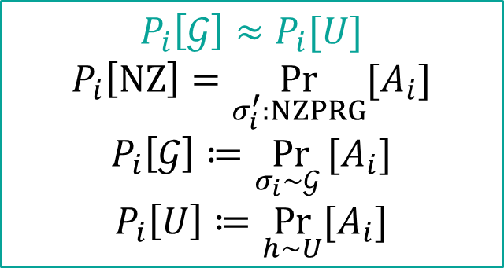



One bin is Sensitive to Multiplicative Error
$$h\left(x\right)=σ_{φ\left(x\right)}^{′}(x)$$
$$\underset{h∼ℋ}{Pr}{[h\left(y\right)=θ∧\min{h\left(X\backslash y\right)}>θ]}$$
$$=$$
$$φ:\left[N\right]→[ℓ]$$
$$P_{1}\left[\text{NZ}\right]⋯P_{j}\left[\text{NZ}\right]⋯P_{ℓ}\left[\text{NZ}\right]$$
$$P_{i}\left[𝒢\right]≈P_{i}[U]$$
$$P_{i}\left[\text{NZ}\right]=\underset{σ_{i}^{′}:NZPRG}{Pr}{[A_{i}]}$$
$$P_{i}\left[𝒢\right]≔\underset{σ_{i}∼𝒢 }{Pr}{[A_{i}]}$$
$$P_{i}\left[U\right]≔\underset{h∼U}{Pr}{[A_{i}]}$$
$σ_{1}^{′},…,σ_{ℓ}^{′}:\left[N\right]→\left[M\right]$ from $\text{NZPRG}$, $\text{ExtErr}=N^{−o(1)}$
$$≈$$
We hope that this special bin does not need to pay for the error from extractor.
$$\left(P_{1}\left[U\right]±\text{ExtErr}\right)⋯\left(P_{j}\left[U\right]±\text{ExtErr}\right)⋯\left(P_{ℓ}\left[U\right]±\text{ExtErr}\right)$$
$$P_{j}\left[U\right]=\underset{h∼U}{Pr}\left[h\left(y\right)=θ∧\min{h\left(X_{j}\backslash y\right)>θ}\right]≤1/M ⟹P_{j}\left[U\right]±\text{ExtErr}=P_{j}\left[U\right]⋅(1±M⋅\text{ExtErr})$$
$P_{j}[U]$ is very small, and it makes this bin very sensitive to multiplicative error.

Slide 26
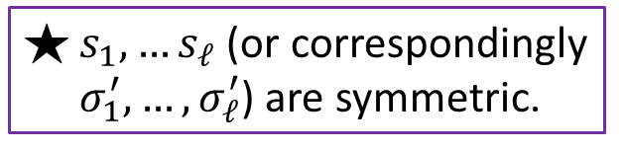
Change the Order of Inputs
$$\left(\min{σ_{1}^{′}\left(X_{1}\right)}>θ\right)∧⋯∧\left(σ_{j}^{′}(y)=θ∧\min{σ_{j}^{′}\left(X_{j}\backslash y\right)>θ}\right)∧⋯∧\left(\min{σ_{ℓ}^{′}\left(X_{ℓ}\right)}>θ\right)$$
$$\text{Ev}\text{ent} A_{1}$$
$$\text{Ev}\text{ent} A_{j}$$
$$\text{Event} A_{ℓ}$$
$$\text{Ext}:{\left\{0,1\right\}}^{p}×{\left\{0,1\right\}}^{d}→𝒢$$
$$σ_{1}^{′}=\text{Ext}\left(w,s_{1}\right),…,σ_{ℓ}^{′}=\text{Ext}(w,s_{ℓ})$$
$$w∼U_{p},s_{1},…,s_{ℓ} \text{i}\text{.}\text{i}\text{.}\text{d}\text{. }\text{from} U_{d}$$
$s_{1},…s_{ℓ}$ (or correspondingly $σ_{1}^{′},…,σ_{ℓ}^{′}$) are symmetric.
$$⋯⋯$$
$$\text{reject}$$
$$A_{1} \text{false}$$
Width: $2$
Length: $ℓ$
Alphabet: $𝒢$
$$v_{\text{start}}$$
$$A_{2} \text{false}$$
$$A_{ℓ} \text{false}$$
$$A_{1} \text{true}$$
$$⋯⋯$$
$$\text{accept}$$
$$A_{2} \text{true}$$
$$A_{ℓ} \text{true}$$
$$σ_{1}^{′}$$
$$σ_{2}^{′}$$
$$⋯⋯$$
$$σ_{ℓ}^{′}$$

Slide 27


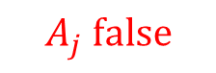







Change the Order of Inputs
$$\left(σ_{j}^{′}(y)=θ∧\min{σ_{j}^{′}\left(X_{j}\backslash y\right)>θ}\right)∧\left(\min{σ_{1}^{′}\left(X_{1}\right)}>θ\right)∧⋯∧\left(\min{σ_{ℓ}^{′}\left(X_{ℓ}\right)}>θ\right)$$
$$\text{Ev}\text{ent} A_{j}$$
$$\text{Ev}\text{ent} A_{1}$$
$$\text{Event} A_{ℓ}$$
$$\text{Ext}:{\left\{0,1\right\}}^{p}×{\left\{0,1\right\}}^{d}→𝒢$$
$$σ_{j}^{′}=\text{Ext}\left(w,s_{j}\right),σ_{1}^{′}=\text{Ext}\left(w,s_{1}\right),…,σ_{ℓ}^{′}=\text{Ext}(w,s_{ℓ})$$
$$w∼U_{p},s_{j},s_{1},…,s_{ℓ} \text{i}\text{.}\text{i}\text{.}\text{d}\text{. }\text{from} U_{d}$$
$$⋯⋯$$
$$\text{reject}$$
$$A_{j} \text{false}$$
Width: $2$
Length: $ℓ$
Alphabet: $𝒢$
$$v_{\text{start}}$$
$$A_{1} \text{false}$$
$$A_{ℓ} \text{false}$$
$$A_{j} \text{true}$$
$$⋯⋯$$
$$\text{accept}$$
$$A_{1} \text{true}$$
$$A_{ℓ} \text{true}$$
$$σ_{j}^{′}$$
$$σ_{1}^{′}$$
$$⋯⋯$$
$$σ_{ℓ}^{′}$$

Slide 28







Change the Order of Inputs
$$\text{Ext}:{\left\{0,1\right\}}^{p}×{\left\{0,1\right\}}^{d}→𝒢$$
$$σ_{j}^{′}=\text{Ext}\left(w,s_{j}\right),σ_{1}^{′}=\text{Ext}\left(w,s_{1}\right),…,σ_{ℓ}^{′}=\text{Ext}(w,s_{ℓ})$$
$$w∼U_{p},s_{j},s_{1},…,s_{ℓ} \text{i}\text{.}\text{i}\text{.}\text{d}\text{. }\text{from} U_{d}$$
$$P_{j}\left[\text{NZ}\right]$$
$$⋅P_{1}\left[\text{NZ}\right]$$
$$⋯P_{ℓ}\left[\text{NZ}\right]$$
$$≈$$
$$(P_{j}\left[U\right]±\text{ExtErr}\text{)}$$
$$⋅(P_{1}\left[U\right]±\text{ExtErr}\text{)}$$
$$⋯(P_{ℓ}\left[U\right]±\text{ExtErr}\text{)}$$
$$P_{i}\left[𝒢\right]≈P_{i}[U]$$
$$P_{i}\left[\text{NZ}\right]≔\underset{σ_{i}^{′} :NZPRG }{Pr}{[A_{i}]}$$
$$P_{i}\left[𝒢\right]=\underset{σ_{i}∼𝒢}{Pr}{[A_{i}]}$$
$$P_{i}\left[U\right]≔\underset{h∼U}{Pr}{[A_{i}]}$$
$$H_{∞}\left(w=U_{p}\right)=p≥k$$
$$⇒\text{Ext}\left(w,s_{j}\right)≈_{ExtErr}𝒢$$
$$\text{Ext}\left(w,s_{j}\right)=𝒢$$
$w$ has no entropy loss at the beginning.
We expect strong properties for $\text{Ext}\left(w,s_{j}\right)$ than other $\text{Ext}(w,s_{i})$.
$$⋯⋯$$
$$\text{reject}$$
$$A_{j} \text{false}$$
Width: $2$
Length: $ℓ$
Alphabet: $𝒢$
$$v_{\text{start}}$$
$$A_{1} \text{false}$$
$$A_{ℓ} \text{false}$$
$$A_{j} \text{true}$$
$$⋯⋯$$
$$\text{accept}$$
$$A_{1} \text{true}$$
$$A_{ℓ} \text{true}$$
$$σ_{j}^{′}$$
$$σ_{1}^{′}$$
$$⋯⋯$$
$$σ_{ℓ}^{′}$$

Slide 29


Change the Order of Inputs
$$\text{Ext}:{\left\{0,1\right\}}^{p}×{\left\{0,1\right\}}^{d}→𝒢$$
$$σ_{j}^{′}=\text{Ext}\left(w,s_{j}\right),σ_{1}^{′}=\text{Ext}\left(w,s_{1}\right),…,σ_{ℓ}^{′}=\text{Ext}(w,s_{ℓ})$$
$$w∼U_{p},s_{j},s_{1},…,s_{ℓ} \text{i}\text{.}\text{i}\text{.}\text{d}\text{. }\text{from} U_{d}$$
$$P_{j}\left[\text{NZ}\right]$$
$$⋅P_{1}\left[\text{NZ}\right]$$
$$⋯P_{ℓ}\left[\text{NZ}\right]$$
$$≈$$
$$(P_{j}\left[U\right]±\text{ExtErr}\text{)}$$
$$⋅(P_{1}\left[U\right]±\text{ExtErr}\text{)}$$
$$⋯(P_{ℓ}\left[U\right]±\text{ExtErr}\text{)}$$
$$P_{i}\left[𝒢\right]≈P_{i}[U]$$
$$P_{i}\left[\text{NZ}\right]≔\underset{σ_{i}^{′} :NZPRG }{Pr}{[A_{i}]}$$
$$P_{i}\left[𝒢\right]=\underset{σ_{i}∼𝒢}{Pr}{[A_{i}]}$$
$$P_{i}\left[U\right]≔\underset{h∼U}{Pr}{[A_{i}]}$$
$$H_{∞}\left(w=U_{p}\right)=p≥k$$
$$⇒\text{Ext}\left(w,s_{j}\right)≈_{ExtErr}𝒢$$
$$\text{Ext}\left(w,s_{j}\right)=𝒢$$
$w$ has no entropy loss at the beginning.
We expect strong properties for $\text{Ext}\left(w,s_{j}\right)$ than other $\text{Ext}(w,s_{i})$.
$$⋯⋯$$
$$\text{reject}$$
$$A_{j} \text{false}$$
Width: $2$
Length: $ℓ$
Alphabet: $𝒢$
$$v_{\text{start}}$$
$$A_{1} \text{false}$$
$$A_{ℓ} \text{false}$$
$$A_{j} \text{true}$$
$$⋯⋯$$
$$\text{accept}$$
$$A_{1} \text{true}$$
$$A_{ℓ} \text{true}$$
$$σ_{j}^{′}$$
$$σ_{1}^{′}$$
$$⋯⋯$$
$$σ_{ℓ}^{′}$$

Slide 30



Special Extractor
Lemma
Given any $p$ and $k<p$, for any error $ε$, there exists an explicit $(k,ε)$-extractor $\text{Ext}:{\left\{0,1\right\}}^{p}×{\left\{0,1\right\}}^{d}→{\left\{0,1\right\}}^{q}$ with $q=k/2$ and $d=O(log⁡(p/ε))$. And $\text{Ext}$ satisfies an extra property: $\text{Ext}(U_{p},s)=U_{q}$for any fixed seed $s$.
$$σ_{j}^{′}=\text{Ext}\left(w,s_{j}\right)=\text{Ext}(U_{p},U_{d})∼𝒢⟹X_{j} \text{has} \text{no} \text{error} \text{from} \text{extractor}$$
$$P_{j}\left[\text{NZ}\right]⋅P_{1}\left[\text{NZ}\right]⋯P_{ℓ}[\text{NZ}]$$
$$P_{j}\left[U\right]⋅\left(P_{1}\left[U\right]±\text{ExtErr}\right)⋯(P_{ℓ}\left[U\right]±\text{ExtErr})$$
$$≈$$

Slide 31

Domain Reduction
$$\text{NZPRG}\left(w, s_{1},…,s_{ℓ}\right)=\left(\text{Ext}\left(w,s_{1}\right),…,\text{Ext}\left(w,s_{ℓ}\right)\right)$$
Use a PRG for ${\left({\left\{0,1\right\}}^{d}\right)}^{ℓ}$-combinatorial rectangles to generate $s_{1},…,s_{ℓ}$, instead of i.i.d. sampling.
Also need the special property of our extractor.
Help us to further reduce the error from $1/\log^{O(1)}{N}$ to $2^{−O\left(\frac{\log{N}}{\log{\log{N}}}\right)}$.

Slide 32

Summary
Main Theorem 1 (Optimal Size && Sub-constant Error, Min-wise Hash)
There exists an explicit min-wise hash family with seed length $O\left(\log{N}\right)$ and error $2^{−O\left(\frac{\log{N}}{\log{\log{N}}}\right)}$.
Main Theorem 2 (Optimal Size && Sub-constant Error, $k$-min-wise Hash)
There exists an explicit $k$-min-wise hash family with seed length $O\left(k\log{N}\right)$ and error $2^{−O\left(\frac{\log{N}}{\log{\log{N}}}\right)}$, for any $k=\log^{O(1)}{N}$.
Main Technical Lemma (Extractor with Extra Properties)
Given any $p$ and $k<p$, for any error $ε$, there exists an explicit $(k,ε)$-extractor $\text{Ext}:{\left\{0,1\right\}}^{p}×{\left\{0,1\right\}}^{d}→{\left\{0,1\right\}}^{q}$ with $q=k/2$ and $d=O(log⁡(p/ε))$. Moreover, $\text{Ext}$ satisfies an extra property: $\text{Ext}(U_{p},s)=U_{q}$for any fixed seed $s$.

Slide 33
Open Problems
Smaller error with optimal seed length?
Extending the result for larger $k$ (like $\sqrt{N}$) on $k$-min-wise hash?
Faster evaluation time with optimal seed length?
Lower bound on $t$-wise independence for $k$-min-wise hash?
More applications of the powerful Nisan-Zuckerman framework?

Slide 34
Thank you for listening!

